Slide 1

Parabola Vertex Not at Origin
RCET 0264 Introductory Calculus
Tim Leishman

Slide 2
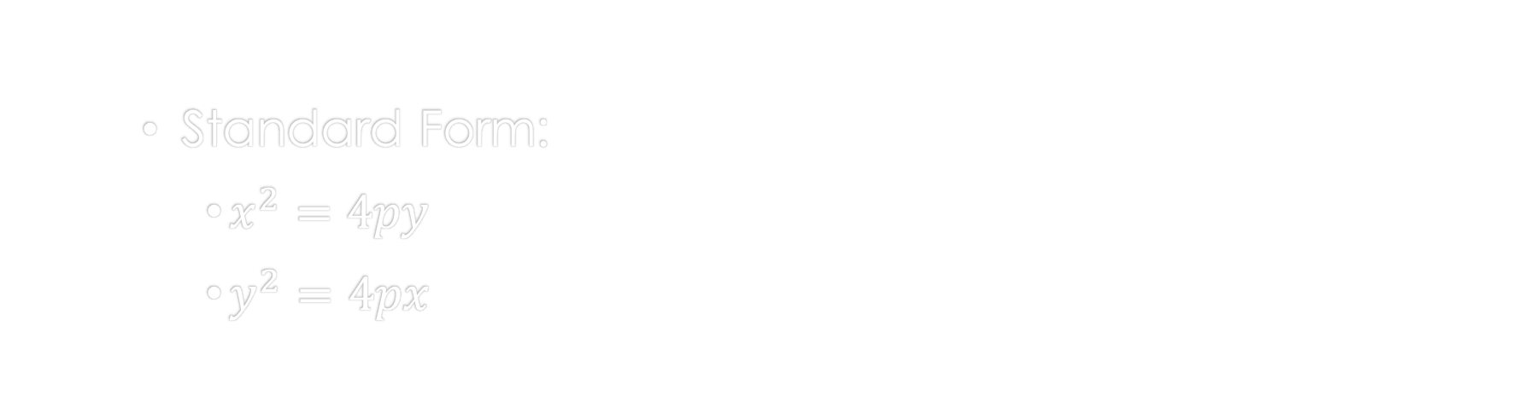
Parabola
Standard Form:
$x^{2}=4py$
$y^{2}=4px$

Slide 3
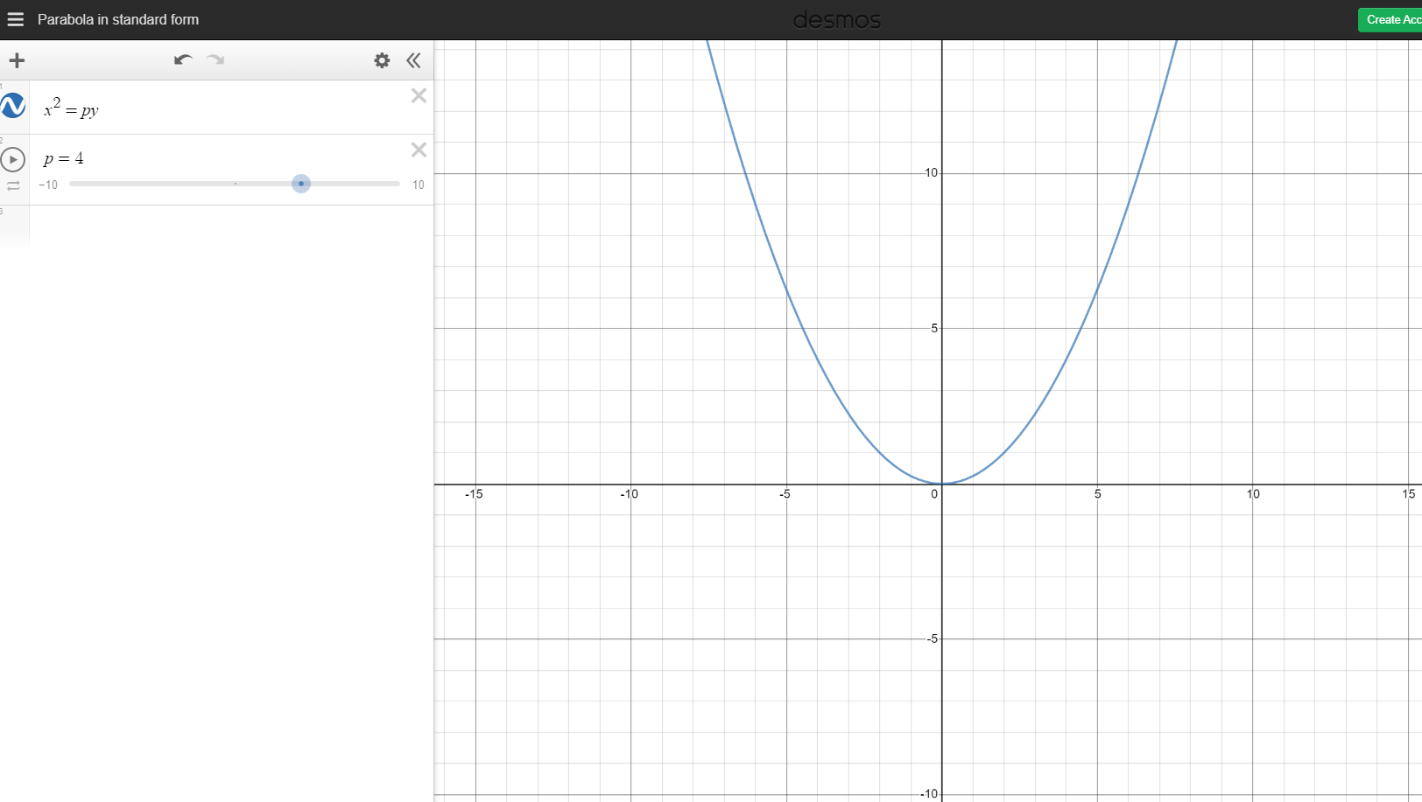
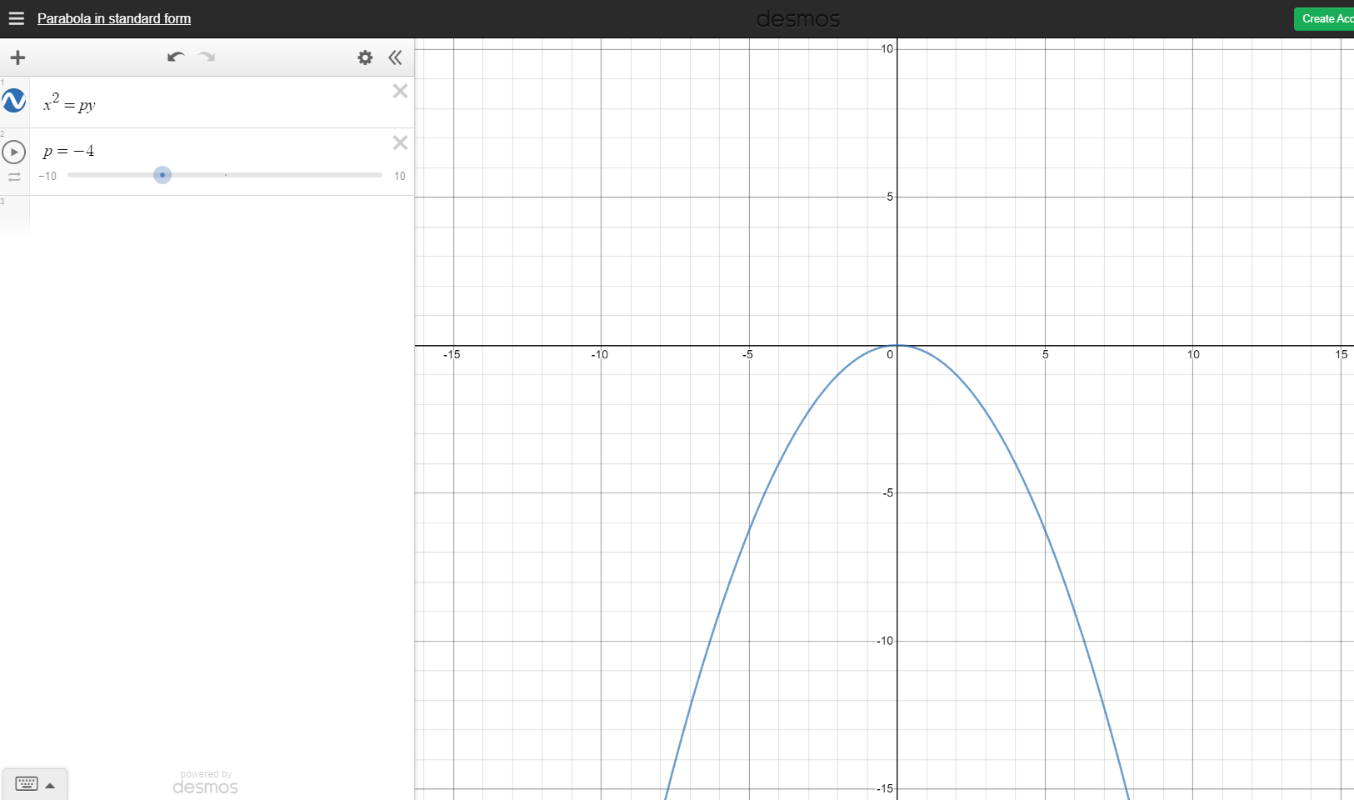
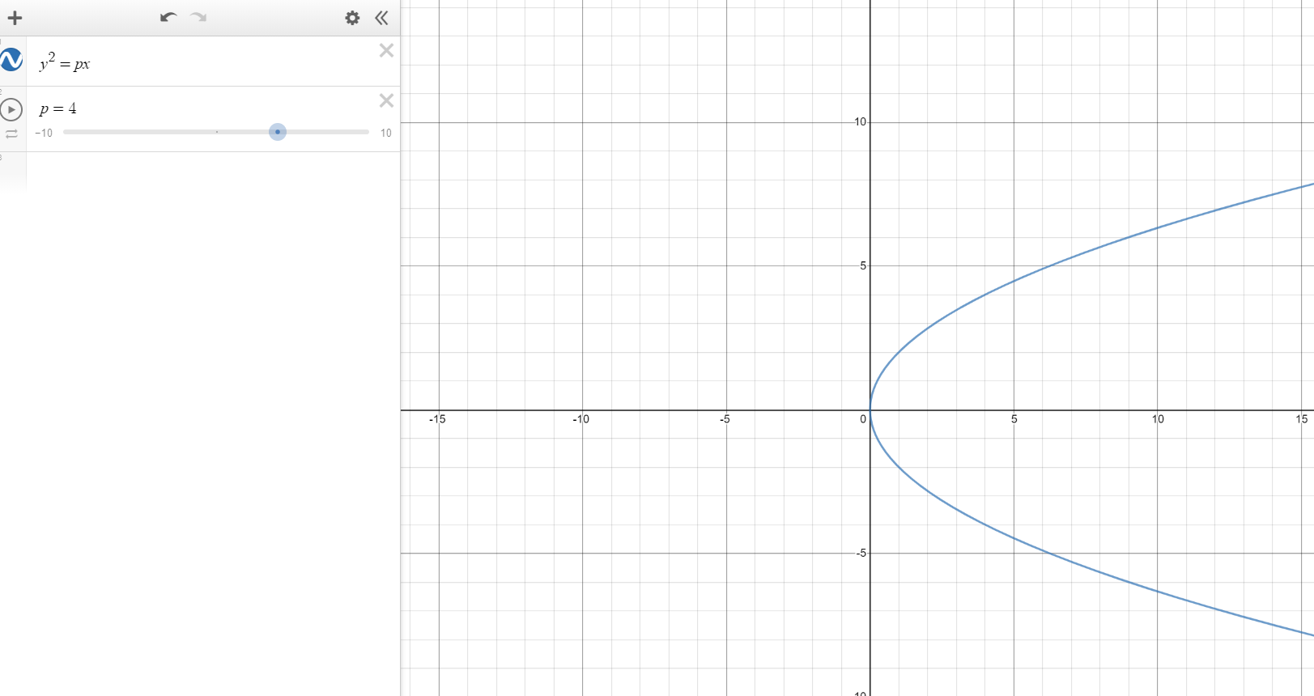
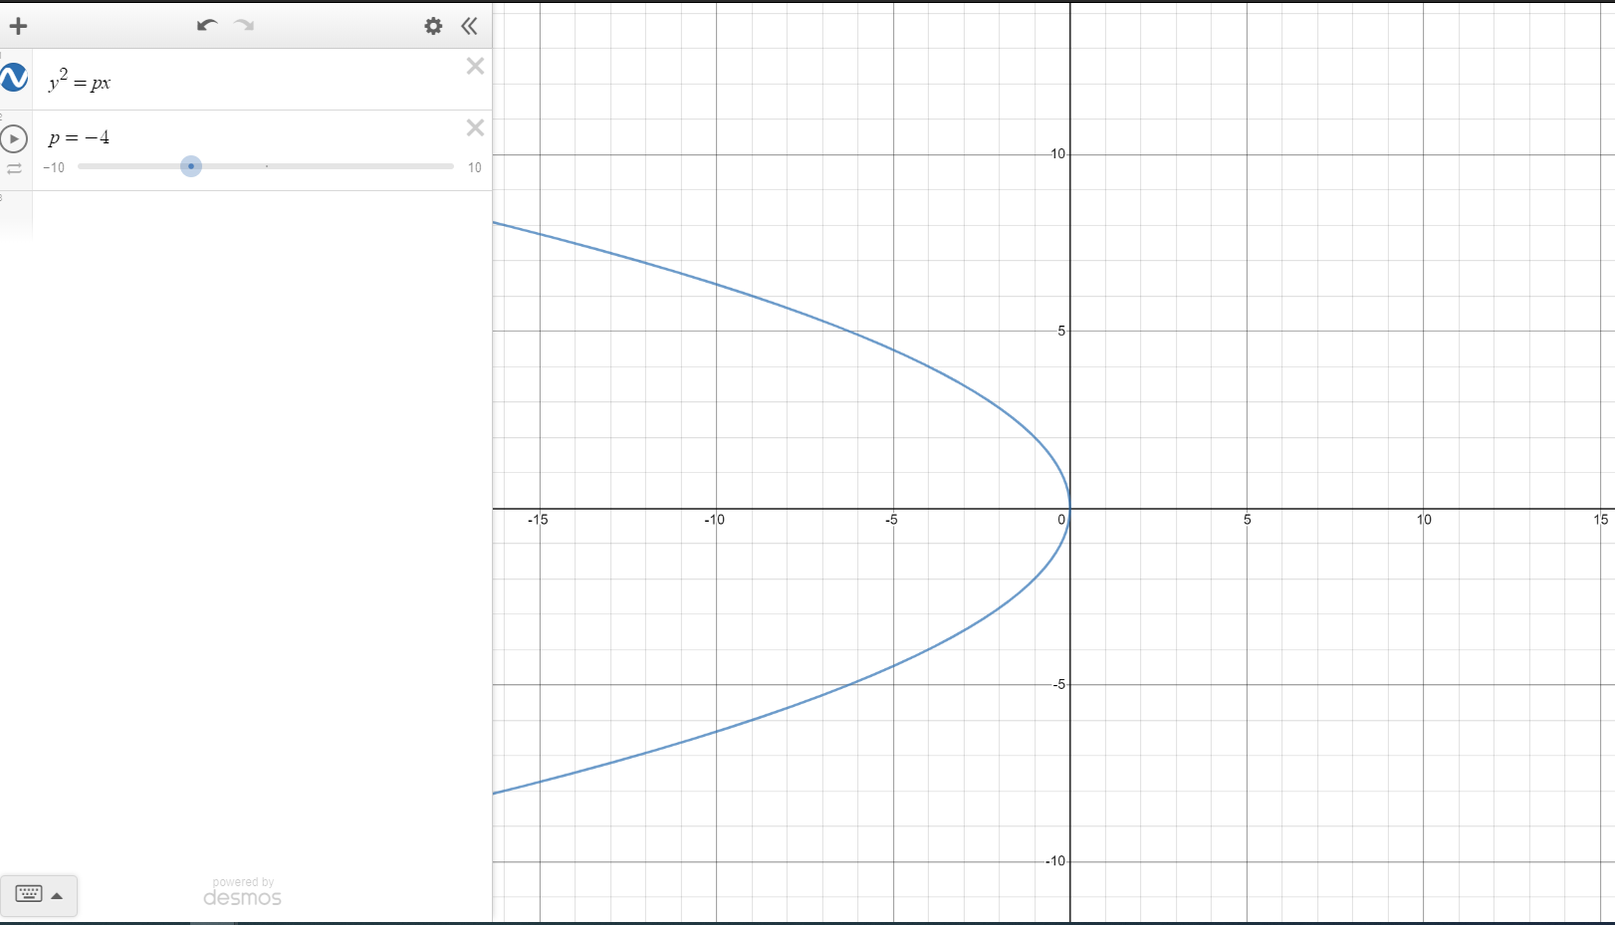
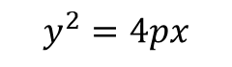
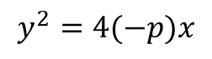
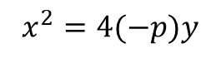
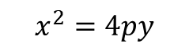
Parabola
$$x^{2}=4(−p)y$$
$$x^{2}=4py$$
$$y^{2}=4px$$
$$y^{2}=4(−p)x$$

Slide 4
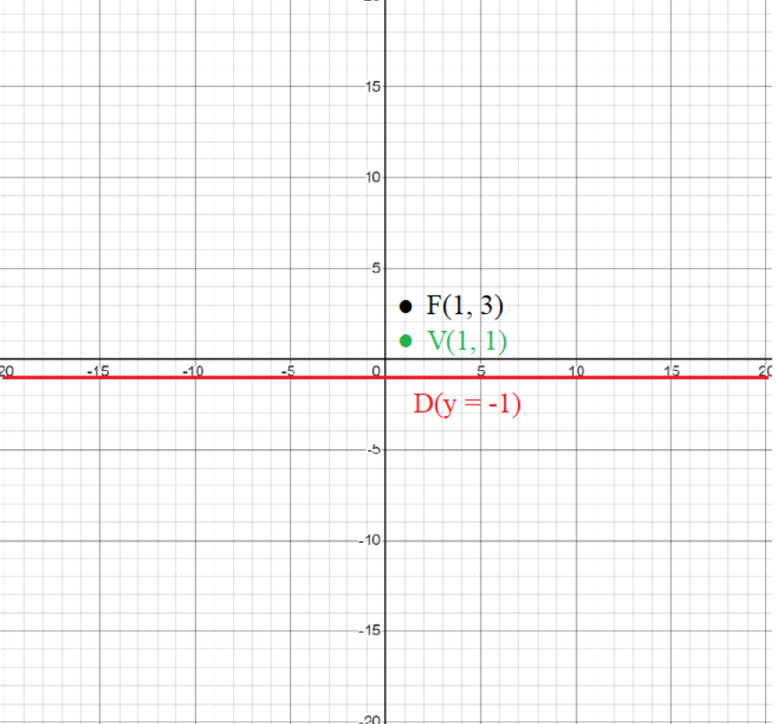
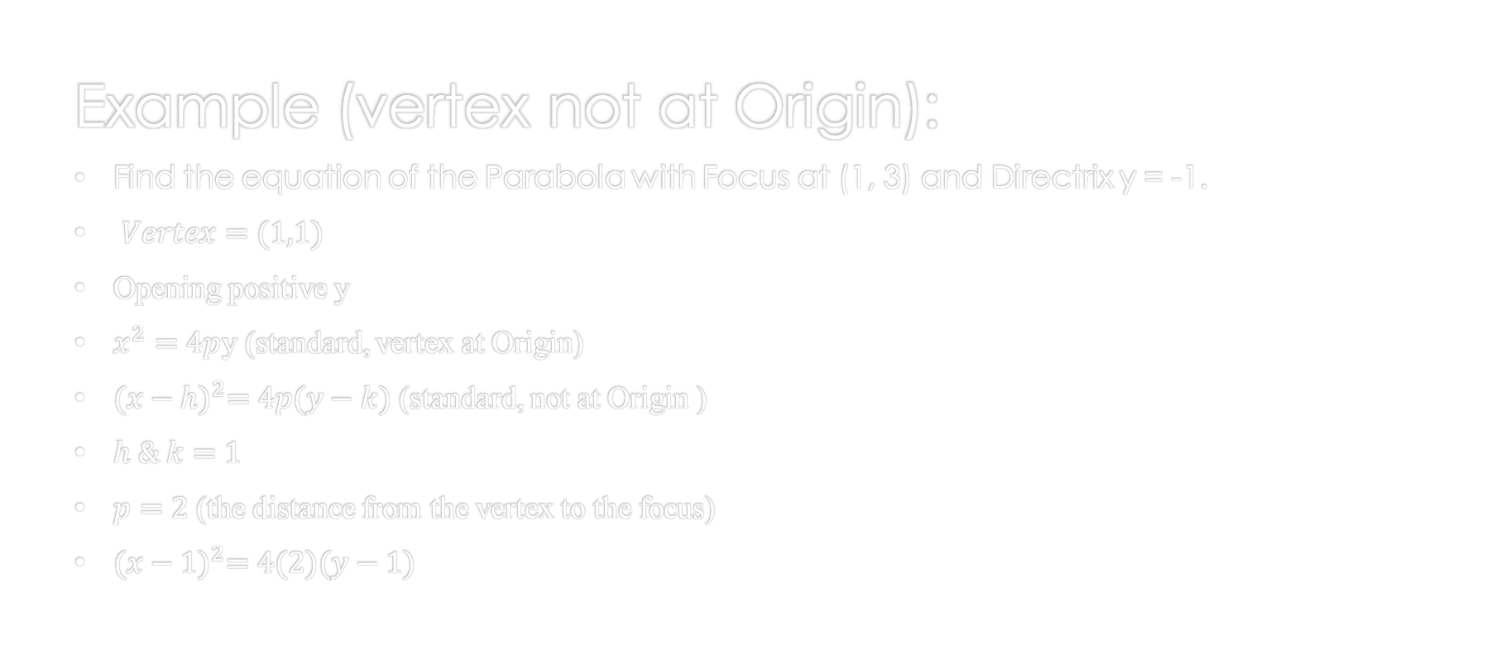
Parabola
Example (vertex not at Origin):
Find the equation of the Parabola with Focus at (1, 3) and Directrix y = -1.
$Vertex=(1,1)$
Opening positive y
$x^{2}=4p$y (standard, vertex at Origin)
${(x−h)}^{2}=4p(y−k)$ (standard, not at Origin )
$h \& k=1$
$p=2$ (the distance from the vertex to the focus)
${(x−1)}^{2}=4(2)(y−1)$

Slide 5
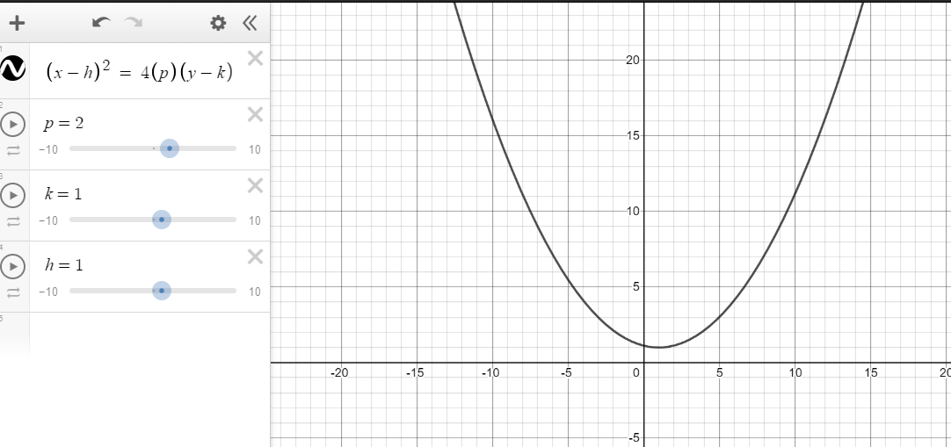
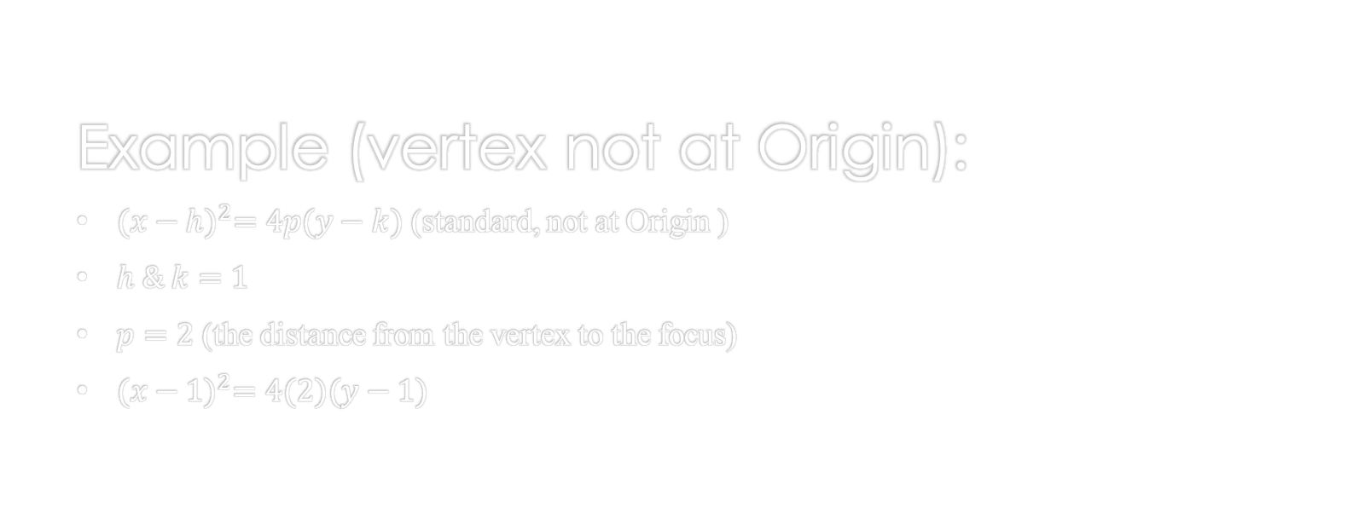
Parabola
Example (vertex not at Origin):
${(x−h)}^{2}=4p(y−k)$ (standard, not at Origin )
$h \& k=1$
$p=2$ (the distance from the vertex to the focus)
${(x−1)}^{2}=4(2)(y−1)$

Slide 6
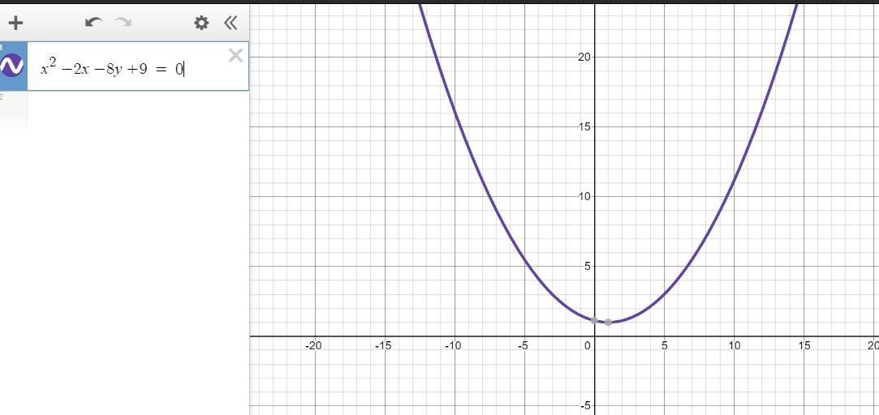
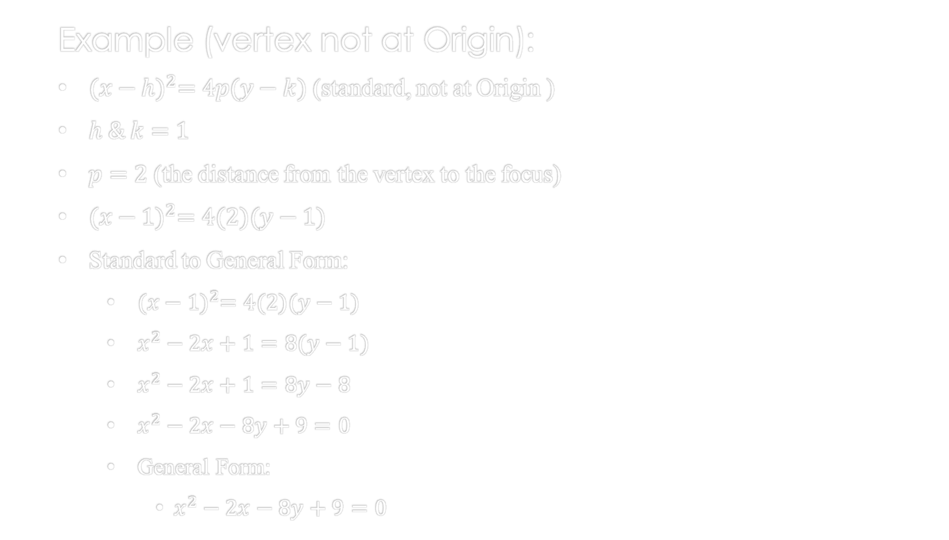
Parabola
Example (vertex not at Origin):
${(x−h)}^{2}=4p(y−k)$ (standard, not at Origin )
$h \& k=1$
$p=2$ (the distance from the vertex to the focus)
${(x−1)}^{2}=4(2)(y−1)$
Standard to General Form:
${(x−1)}^{2}=4(2)(y−1)$
$x^{2}−2x+1=8(y−1)$
$x^{2}−2x+1=8y−8$
$x^{2}−2x−8y+9=0$
General Form:
$x^{2}−2x−8y+9=0$
Standard Form
General Form

Slide 7
Parabola
References:
Ewen, D., Gary, J. S., & Trefzger, J. E. (2005). Technical calculus. Upper Saddle River, NJ: Pearson/Prentice Hall.
https://www.desmos.com/calculator/zs5wfg9uem

